Slide 1
Sessions 5 & 6 The Statement of Cash Flows

Slide 2
Basis OF ACCOUNTING
Accrual basis: Recognition of revenues and expenses as they occur in the sense of meeting criteria for operating transactions.
Cash basis: Recognition of revenues and expenses as cash is received or expended in relation to operating activities.

Slide 3
Adjusting entries
Why?
Recognize revenues and match expenses
Differentiate from CF accounting
When?
End of accounting period
What?
Revenues earned and expenses incurred but not recorded yet
Deferred revenues and deferred expenses
Accrued revenues and accrued expenses

Slide 4
Accruals - Revenues
Receive cash before delivering product or service (e.g., before revenue):
Termed Deferred revenue (Cl or NCL).
This period NI less than CFO
Receive cash after delivering product or service:
Termed Accounts receivables (CA or NCA).
This period NI more than CFO

Slide 5
Accruals - Expenses
Pay cash before incurring expense:
Termed prepaid (CA, examples inventory, prepaid interest, prepaid tax, prepaid salary, prepaid rent, prepaid utility ….).
This period NI more than CFO
Pay cash after incurring expense:
Termed payables (CL, examples accounts payable, interest payable, tax payable, salary payable rent payable, utility payable ….).
This period NI less than CFO

Slide 6
Notice
These journal entries always affect both the income statement and the balance sheet
These entries never involve cash
These four types of transactions are the heart of Accrual accounting.
Cash accounting will never have such entries.

Slide 7
CF Statement
The statement of cash flows (SCF) is, in essence, a rearrangement of the cash T-account in an informative way. The SCF describes the annual flows of cash and is divided into three sections:
Cash flows from operations,
Cash flows from investing activities
Cash flows from financing activities.
The cash flow statement explains the change in cash and hence the beginning and ending cash on the cash flow statement correspond to the beginning and ending cash on the balance sheet
Like net income, cash flow is used to evaluate company performance

Slide 8
Why do we care about the statement of CF?
Better prediction of bankruptcy?
Less manipulation?
Importance of distinguishing between Operating CF and Investing and Financing CF.
P =

Slide 9
Cash flows from operations
Cash related to a company’s primary operations
Inflows:
Cash collected from customers
Interest and dividends received
Outflows
Cash paid to suppliers and employees
Interest paid
Taxes paid

Slide 10
Calculating operating cash flows
Direct method
Identify each cash transaction and separate those that belong in CFO.
Complicated if firm has many transactions in a fiscal period
Not used by many companies
Indirect method
Starts with Net Income (from I/S) and reconciles Net Income to CFO.
Simpler for companies with more complex operations
Highlights differences between Net Income and CFO.

Slide 11
Example of Direct Method CFO: Arden Group

Slide 12
Indirect method
Starts with Net Income (NI) and makes the following adjustments:
Remove items included in NI that never have a cash flow effect
Add non-cash expenses (e.g., depreciation)
Adjust for changes in operating assets and liabilities
Subtract net change in current assets other than cash
(e.g., AR, Inventory, pre-paid rent)
Add net change in current liabilities
(e.g., AP, Unearned revenue, Interest payable, Tax payable,…)
Subtract (add back) non-operating gains (losses) included in NI
- For example, the gain/loss from sale of property

Slide 13
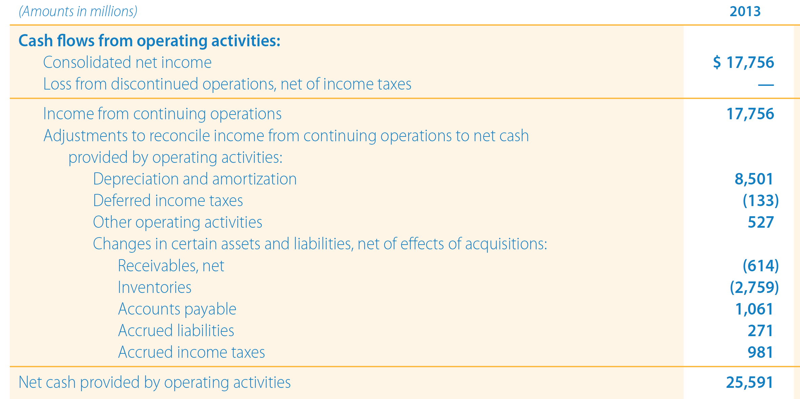
Indirect method - Walmart

Slide 14
Preparing cash flows from operations
Consider the partial balance sheets and income statement of Cash-We-Need Co.:

Slide 15
Cash flow from operations: The direct method
Cash collected from customers
In accrual accounting a firm records revenues from sales for both cash sales and credit sales.
Furthermore, revenue is only recognized when the product / service has been provided.
Hence, we need to account for ∆A/R and ∆D/R
Let us explain it in three ways

Slide 16
Journal entry
Journal entry: we know three things
Accounts receivable increased by 20
Deferred revenue decreased by 20
Sales revenues increased by 500
Cash: unknown.
Then we must have the following journal entry
Accounts receivable 20
Deferred revenue 20
Cash X
Sales revenues 500
So Cash must have increased by 460

Slide 17
T account method
T account method.
Assume all sales are on credit, how much did we collet during the period? Revenues - ∆A/R = 500-20 = 480
However, Deferred revenue decreased by 20. That means that 20 of the revenue recognized this period did not come in cash (rather it was collected in the previous period) => cash revenues are 460.
A/R D/R
BB 80 BB 30
Sales 500 Collections ? Revenue ?
EB 100 EB 10

Slide 18
Formula method
Formula method
Mathematically, preparing the statement of cash flows can be thought of as rearranging the accounting equation, A = L+E
We can explain the change in cash by explaining the change in all other balance sheet accounts.
∆cash = ∆CL+∆NCL+∆E-∆CA (other than cash)-∆NCA
∆E = net income - dividends+ ∆Contributed capital
∆cash from operations = ∆CL (plus change in non-current operating liabilities) – ∆CA (other than cash) + NET INCOME
So: Revenues - ∆A/R + ∆D/R = 500-20-20 = 460

Slide 19
Cash flow from operations: The direct method
Cash paid Cash paid to suppliers and employees
In accrual accounting a firm records expense when the goods are eventually sold (COGS).
Hence, an increase in inventory results in a cash outflow that is not an expense.
Similarly, inventory bought on account results in an asset increase but no cash outflow.
.
Hence, we need to account for ∆inventory and ∆A/P
Let us explain it in three ways

Slide 20
Journal entries
Journal entries: What do we know?
Inventory increased by 30
A/P increased by 10
Cost of goods sold Increased by 380
Cash unknown.
Then we must have the following journal entry
Inventory 30
Cost of goods sold 380
A/P 10
Cash X
So Cash must have decreased by 400 (Cash paid to suppliers).

Slide 21
Cash flow from operations: The direct method
T-accounts
Cash paid to suppliers and employees
Inventory A/P
BB 60 20 BB
Purchases (cash + credit)X 380 Sales 10 (plug)
EB 90 30 EB
So X Is equal to 410 (60 + X – 380 = 90), but 10 was credit purchase => cash purchases were 400.

Slide 22
Formula
Formula: COGS - ∆Inventory + ∆A/P = -380-30+10= -400
Notice: net income = revenues – expenses.
Hence COGS has a minus sign before it.
Logically, expenses are outflows of cash.

Slide 23
cash flows from operations
Direct Metho
Cash collected from customers 460
Cash paid to suppliers -400
Increase in cash during the period 60
Indirect Method
Net income 70
- ∆A/R -20
- ∆Inventory -30
+ ∆A/P 10
+ ∆D/R -20
+ Non-cash expense 50
Net Increase in cash 60

Slide 24
Cash flow from operations: The indirect method
Mathematically, preparing the statement of cash flows can be thought of as rearranging the accounting equation, A = L+E
We can explain the change in cash by explaining the change in all other balance sheet accounts.
∆cash = ∆CL+∆NCL+∆E-∆CA (other than cash)-∆NCA
∆E = net income - dividends+ ∆Contributed capital
∆cash from operations = ∆CL (plus change in non-current operating liabilities) – ∆CA (other than cash) + NET INCOME
However, NET INCOME = Cash Revenues + Non-cash Revenues – Cash Expenses – Non-Cash Expenses
Since we want to isolate the cash then:
NET INCOME – Non-cash Revenue from operations + Non-Cash Expenses = Cash Revenues– Cash Expenses
Hence: ∆cash from operations = ∆CL (plus change in non-current operating liabilities) – ∆CA (other than cash) + NET INCOME – Non-cash Revenues + Non-Cash Expenses

Slide 25
Observations
Both formats arrive at exactly the same number for cash flow from operations
The formats only differ in how they derive cash flow from operations
Companies that use the direct method to compute operating cash flow must also include an indirect method reconciliation; companies that report using the indirect method have no requirement to also report direct method cash computations => Most companies report only the indirect method
Investing and financing cash flows both use a format similar to the direct method

Slide 27
Referring to the previous FS of Alico
Additional information:
Revenues for fiscal 2014: 88,680
COGS for fiscal 2014: 68,590
Assuming that A/P and inventory only relate to COGS, how much did Alico pay to suppliers during the year ended 9/30/2014?
Assuming that A/R only relate to revenues, how much did Alico collect from sales during the year ended 9/30/2014?

Slide 29
Referring to the previous FS of Walmart
Additional information:
Revenues for fiscal 2012: 466,114
COGS for fiscal 2012: 352,488
Assuming that A/P and inventory only relate to COGS, how much did Walmart pay to suppliers during the year ended 1/31/2013?
Assuming that A/R only relate to revenues, how much did Walmart collect from sales during the year ended 1/31/2013?

Slide 30
Cash Flow From Investing Activities
Cash flow from investing activities measure the amount of cash generated and used by the firm as a result of purchases or sales of long-lived tangible or intangible assets and other investment assets (e.g. securities of other firms)
Will typically involve non-current asset accounts.
Investing cash inflows | Investing cash outflows
Disposal of long-lived assets | Purchase of long-lived assets
Sale of other firm’s securities | Purchase of other firm’s securities
Receipt of loan repayment | Giving out loans to other firms

Slide 31
Cash Flow From Financing Activities
Cash flow from financing activities measure the amount of cash generated and used by the firm as a result of issuing or repurchasing equity or debt.
Will typically involve non-current liabilities or equity.
FInancing cash inflows | Financing cash outflows
Proceeds from issuing stock | Stock repurchase
Proceeds from borrowing money/ issuing bonds | Principal portion of loan/bond payments
 | Dividend payments

